Slide 1
Software Engineering
Unit-2
Software Development Life Cycle (SDLC)

Slide 2
Generic Process Model
The generic process model is an abstraction of the software development process. It is used in most software since it provides a base for them.
The generic process model encompasses the following five steps:
Communication
Planning
Modelling
Construction
Deployment

Slide 3
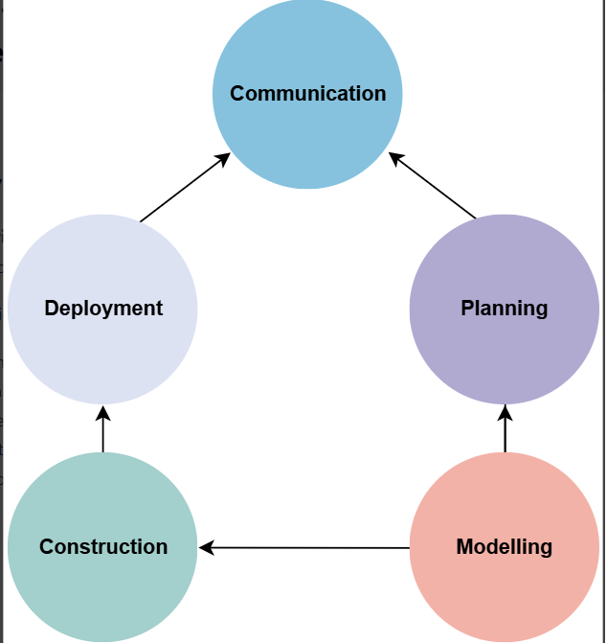
Generic Process Model

Slide 4
Generic Process Model
Communication
In this step, we communicate with the clients and end-users.
We discuss the requirements of the project with the users.
The users give suggestions on the project. If any changes are difficult to implement, we work on alternative ideas.
2. Planning
In this step, we plan the steps for project development. After completing the final discussion, we report on the project.
Planning plays a key role in the software development process.
We discuss the risks involved in the project.

Slide 5
Generic Process Model
3. Modelling
In this step, we create a model to understand the project in the real world. We showcase the model to all the developers. If changes are required, we implement them in this step.
We develop a practical model to get a better understanding of the project.
4. Construction
In this step, we follow a procedure to develop the final product.
If any code is required for the project development, we implement it in this phase.
We also test the project in this phase.
5. Deployment
In this phase, we submit the project to the clients for their feedback and add any missing requirements.
We get the client feedback.
Depending on the feedback form, we make the appropriate changes.

Slide 6
Prescriptive Process Models
Prescriptive process models are traditional software development models that follow a structured and well-defined sequence of steps. They prescribe a strict approach to software development, ensuring predictability, discipline, and organization in the development process. These models are useful for projects that require well-documented and sequential progress.
Key Characteristics of Prescriptive Models
Linear and sequential approach (Step-by-step execution)
Well-defined phases (Planning, design, development, testing, deployment)
Strict documentation and planning
Less flexibility to changes
Best suited for well-understood projects with clear requirements

Slide 7
The Waterfall Model
Waterfall approach was first SDLC Model to be used widely in Software Engineering to ensure success of the project. In "The Waterfall" approach, the whole process of software development is divided into separate phases. In this Waterfall model, typically, the outcome of one phase acts as the input for the next phase sequentially.
The sequential phases in Waterfall model are −
Requirement Gathering and analysis − This is the first phase where all project requirements are gathered from the client or stakeholders. The objective is to correctly define the software’s features, functions, and user needs. A solid foundation is created by this phase for the entire project.

Slide 8
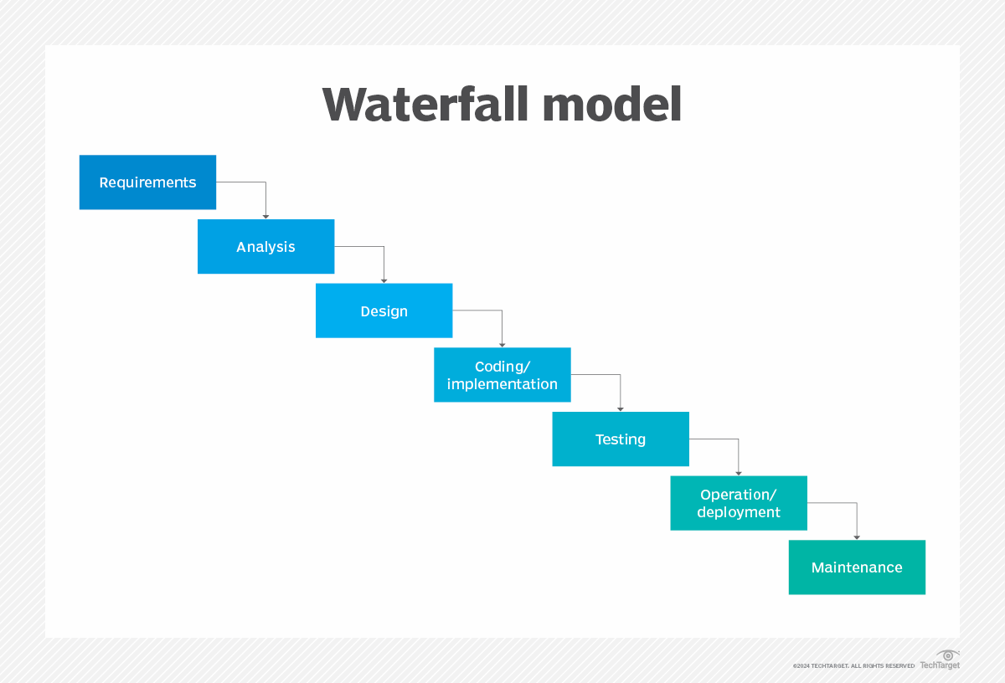
The Waterfall Model

Slide 9
The Waterfall Model
2. System Design − Here, the software architecture and design are planned according to requirements. Designers create detailed models, user interfaces, and system structures, laying out how the software will work technically.
3. Implementation − In this phase, the developers start with writing the actual code. They leverage the designs and specifications from the previous phase to build the software system and align it with the defined requirements.
4. Integration and Testing -
After coding, the software is integrated, and testing is conducted to detect bugs and issues. This ensures that the software works correctly and meets the original requirements. This phase includes unit testing, system testing and acceptance testing.

Slide 10
The Waterfall Model
5.Deployment -
Once testing is complete and the software is fully functional, it’s deployed to the production environment. This is when the software is made available for end users.
6. Maintenance -
After deployment, the software is in the maintenance phase. It involves fixing bugs, making updates, and adding new features as needed. This phase makes sure that the software remains functional and up-to-date.

Slide 11
Waterfall Model - Advantages
Simple and easy to understand and use
Easy to manage due to the rigidity of the model. Each phase has specific deliverables and a review process.
Phases are processed and completed one at a time.
Works well for smaller projects where requirements are very well understood.
Clearly defined stages.
Well understood milestones.
Easy to arrange tasks.
Process and results are well documented

Slide 12
Waterfall Model - Disadvantages
High amounts of risk and uncertainty.
Not a good model for complex and object-oriented projects.
Poor model for long and ongoing projects.
Not suitable for the projects where requirements are at a moderate to high risk of changing. So, risk and uncertainty is high with this process model.
It is difficult to measure progress within stages.
Cannot accommodate changing requirements.
Adjusting scope during the life cycle can end a project.

Slide 13
Incremental Process Models
The Incremental Process Model is a method of software development where the system is built step by step.
Instead of delivering the whole system at once, it is developed and delivered in small parts called increments.
Each increment builds upon the previous one by adding new functionality, until the complete system is finished.

Slide 14
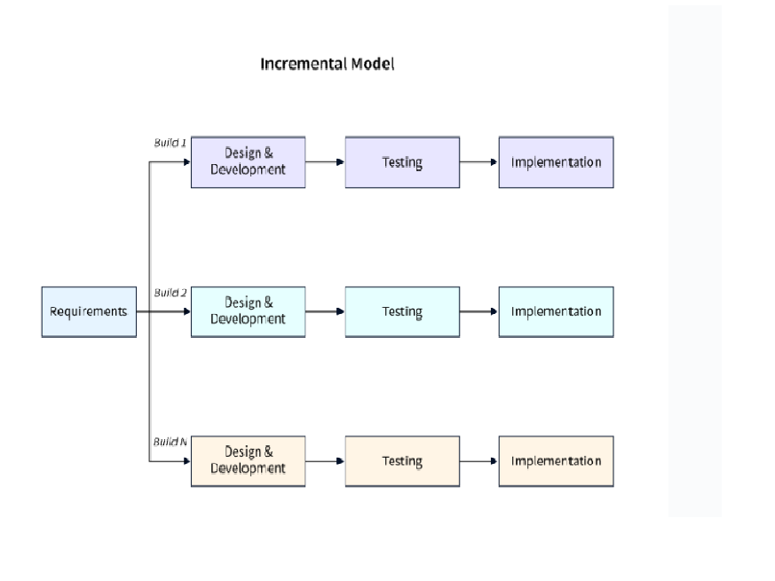
Incremental Process Models

Slide 15
Incremental Process Models
Requirements Gathering: In this initial phase, the high-level requirements for the software are gathered and analyzed. These requirements serve as a foundation for the subsequent phases.
Design: Based on the gathered requirements, the software's architecture, design, and user interfaces are planned and developed. The design is often divided into smaller segments to ensure a focused and organized development process.

Slide 16
Incremental Process Models
Implementation: Each increment involves implementing a portion of the software's functionality. Developers work on adding features, modules, or components that were planned in the design phase. This incremental approach allows for quicker delivery of usable software.
Testing: As each increment is completed, testing is carried out to ensure that the new features work as expected and do not negatively impact the existing functionality. This ongoing testing helps catch and address issues early in the development process.
Integration: In this phase, the newly developed increments are integrated into the existing software. This can involve merging code, resolving conflicts, and ensuring that all components work together smoothly.

Slide 17
Incremental Process Models
Evaluation and Feedback: After each increment, stakeholders review the functionality added and provide feedback. This feedback can be used to refine the requirements, design, and implementation of subsequent increments.
Iterative Process: The software development process iterates through the above phases, gradually adding new features and improvements. With each iteration, the software becomes more robust and feature-rich.

Slide 18
Incremental Process Models Advantages
Generates working software quickly and early during the software life cycle.
More flexible.
Easier to test and debug during a smaller iteration.
Customer can response to each bolt.
Lowest initial delivery cost.
Easy to manage risk.

Slide 19
Incremental Process Models Disadvantages
Complexity in Integration: Integrating new increments with existing components can be challenging, especially if the architecture wasn't designed with incremental development in mind. This can lead to compatibility and stability issues.
Continuous Maintenance Overhead: As increments are added, maintaining and updating them can become complex, leading to increased maintenance overhead over the lifecycle of the software.
Limited Overall View: Since the software is developed incrementally, there might not be a comprehensive overview of the final product until all increments are integrated, potentially leading to discrepancies in overall design and functionality.

Slide 20
Incremental Process Models Disadvantages
Incomplete Features: Depending on the chosen increments, some critical features might not be available until later stages of development, which could hinder the usability of the software during early releases.
Dependency Management: If one increment relies on the functionality of another, delays in one increment can impact the overall project timeline and deliverables.
Increased Coordination Effort: Managing the development and integration of multiple increments requires effective coordination and communication among development teams, which can become complex as the project progresses.

Slide 21
Evolutionary Process Models
Evolutionary model is a combination of Iterative and Incremental model of software development life cycle.
The evolutionary model is based on the concept of making an initial product and then evolving the software product over time with iterative and incremental approaches with proper feedback.
In this type of model, the product will go through several iterations and come up when the final product is built through multiple iterations
The development is carried out simultaneously with the feedback during the development.

Slide 22
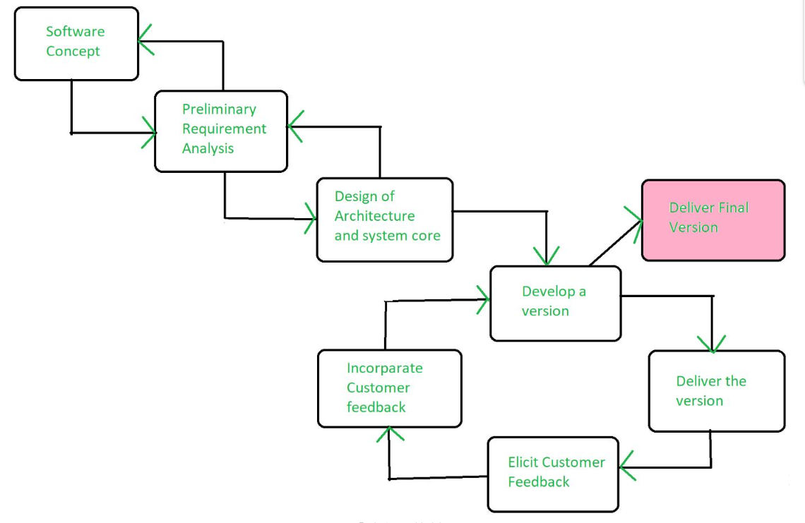
Evolutionary Process Models

Slide 23
Advantages of the Evolutionary Process Model
During the development phase, the customer gives feedback regularly because the customer's requirement gets clearly specified.
After every iteration risk gets analyzed.
Suitable for big complex projects.
The first build gets delivered quickly as it used an iterative and incremental approach.

Slide 24
Disadvantages of the Evolutionary Process Model
It is not suitable for small projects.
The complexity of the spiral model can be more than the other sequential models.
The cost of developing a product through a spiral model is high.

Slide 25
Concurrent Models
The Communication activity has completed in the first iteration and exits in the awaiting changes state.
The modeling activity completed its initial communication and then go to the under development state.
If the customer specifies the change in the requirement, then the modeling activity moves from the under development state into the awaiting change state.
The concurrent process model activities moving from one state to another state.

Slide 26
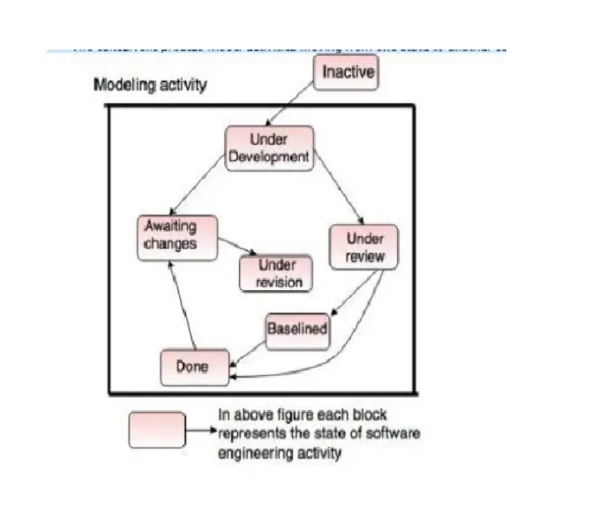
Concurrent Models

Slide 27
Advantages of Concurrent Models
This model is applicable to all types of software development process.
It is easy for understanding and use.
It gives immediate feedback from testing.
It provides an accurate picture of the current state of a project.

Slide 28
Disadvantages of Concurrent Models
It needs better communication between the team members. This may not be achieved all the time.
It requires to remember the status of the different activities.

Slide 29
The Unified Process
The Unified Process (UP) in Object-Oriented Analysis and Design (OOAD) is a software development methodology that emphasizes iterative development, collaboration, and flexibility.
It is based on the Unified Modeling Language (UML) and is characterized by its use of use cases to drive development, its focus on architecture-centric development, and its emphasis on risk management and incremental delivery.

Slide 30
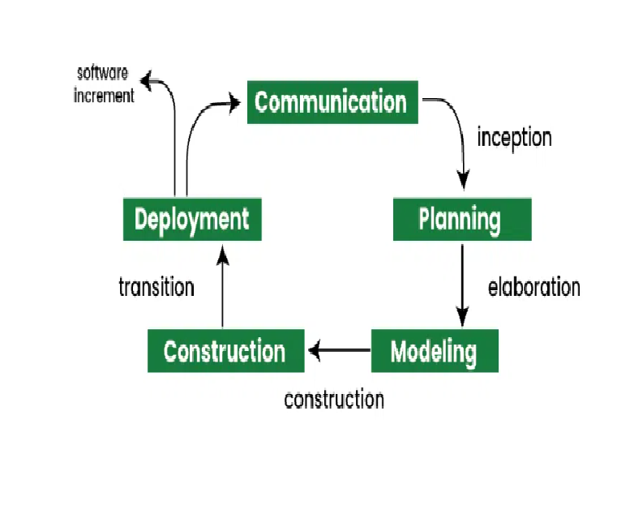
The Unified Process

Slide 31
Phases of Unified Process
1. Inception
This is the initial phase where the project's scope, objectives, and feasibility are determined.
Key activities in this phase include identifying stakeholders, defining the initial requirements, outlining the project plan, and assessing risks.
The goal of this phase is to establish a solid foundation for the project and ensure that it is worth pursuing.
2. Elaboration
In this phase, the project requirements are analyzed in more detail, and the architecture of the system is defined.
Key activities include developing use cases, creating the architectural baseline, identifying key components, and refining the project plan.
The goal of this phase is to mitigate major risks and establish a solid architectural foundation for the project.

Slide 32
Phases of Unified Process
3.Construction
This is the phase where the actual implementation of the system takes place.
Key activities include developing, testing, and integrating the system components, as well as continuously verifying that the system meets the requirements.
The goal of this phase is to build a complete, high-quality software product that is ready for deployment.
4. Transition
In this final phase, the software is deployed to end users.
Key activities include user training, final system testing, and transitioning the system to the operations and maintenance team.
The goal of this phase is to ensure a smooth transition from development to production and to address any issues that arise during deployment.

Slide 33
Reverse Engineering
Reverse engineering can extract design information from source code, but the abstraction level, the completeness of the documentation, the degree to which tools and a human analyst work together, and the directionality of the process are highly variable.
Reverse engineering can help cut costs in product development by finding replacements or cost-effective alternatives for systems or components.
Reverse engineering is used in cybersecurity to examine exploits, vulnerabilities, and malware. This helps in understanding of threat mechanisms and the development of practical defenses by security experts.
Through the process of reverse engineering, developers can incorporate or modify hardware or software components into pre-existing systems to improve their operation or tailor them to meet particular needs.

